Slide 1
Color recognition

Slide 2
Q>Before we begin , lets take a minute to define the term color?.
ANS: Color can be defined as the ability to identify a object.
Without color there s no instance to define any objects.
Color can enhance a object specification and attractive.

Slide 3
objective
The objective of our project to obtain a comprehensive image recognition techniques. This algorithm is simple as well as powerful. The objective of this algorithm is to read an image. Then analyze the Red, Green, Blue color quantity of a particular pixel point and calculate the percentage of their quantity.

Slide 4
INTRODUCTION
The user can select an image
The user can select a single pixel position or more than one pixel position.
The user can analyze the RGB percentage of those points.

Slide 5
curriculum
Now day by day image is the most important for us.
We are updated in social networking sites.
We used to do clicked images and edit it.
Our project is also a editing purpose software
That a user can rectify or generate its user defined image how they can wants to do

Slide 6
What is RGB
RGB is nothing but the RED GREEAN AND BLUE.
RGB us a special type of scale how a picture can measure in our display unit like monitor.
RGB is the primary color concept in the picture.
A picture is generated using RGB concept.
Eg: more types of scales are RGB,GRAY,HSV etc

Slide 7
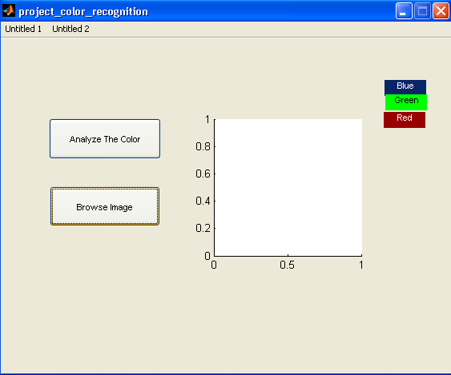
BROWSE AN IMAGE

Slide 8
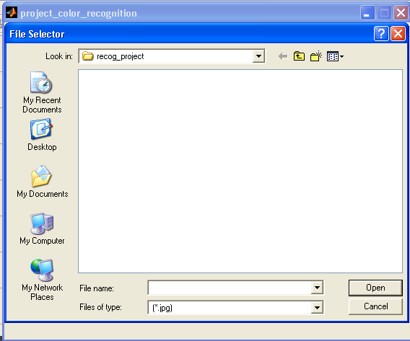
SEARCH THE PATH OF THE IMAGE

Slide 9
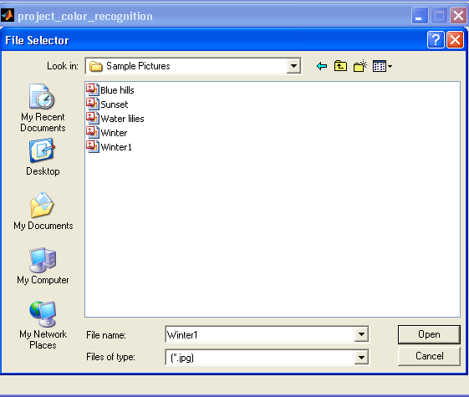
SELECTING A PICTURE WHICH ITHER (*.jpg,*.png)

Slide 10
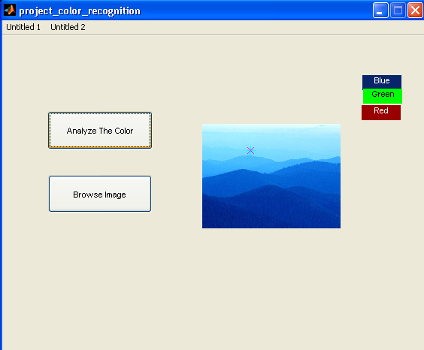
ANALYZE THE PURSENTAGE OF RGB(RED GREEN BLUE)

Slide 11
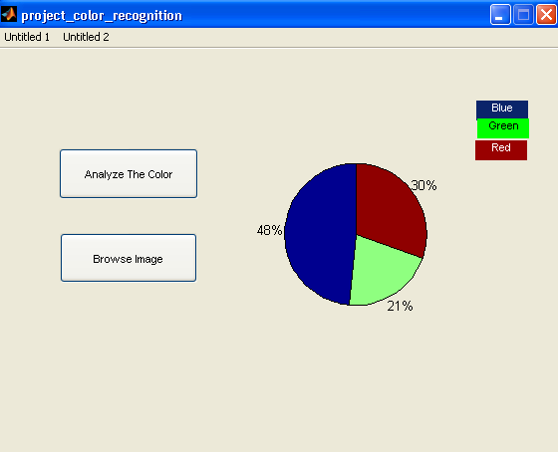
PREDICTABLE OUTPUT GENATATE BY THE SYSTEM

Slide 12
NAME OF THE PROJECT MEMBERS
DEBIBRATA BEJ(PROJECT LEADER)
REBHU ROY
PRITAM MUNSHI
ABIR DAS

Slide 13
Thank You………………………….

